Slide 1
Scheduling Final Project
By: Navya Ravavarapu

Slide 2
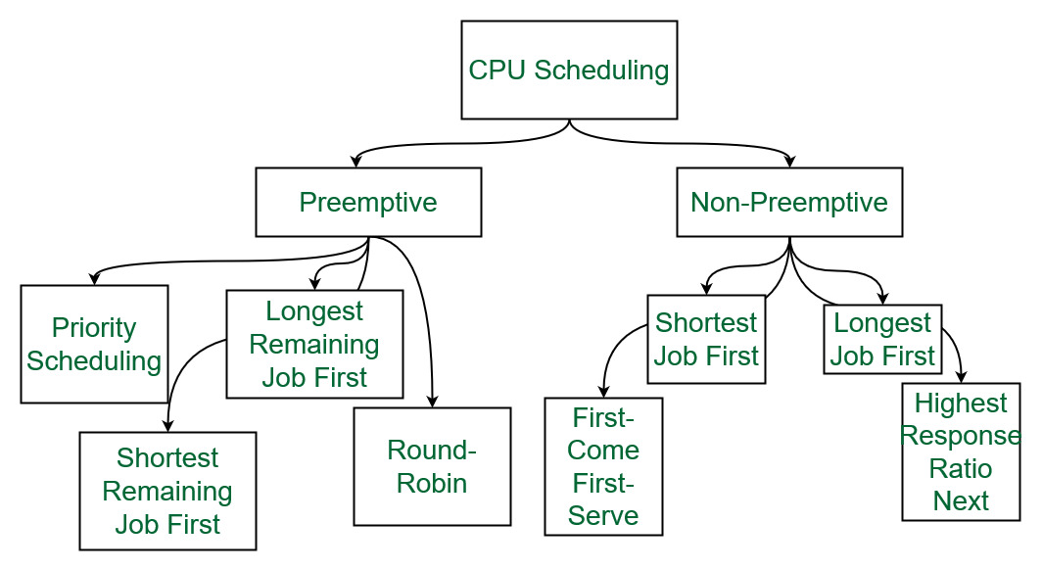
CPU Scheduling
CPU Scheduling is essentially the method that is used to switch between processes as they are being executed.
There are 2 Types of Scheduling:
Preemptive scheduling is when a process transitions from a running state to a ready state or from a waiting state to a ready state
Non-preemptive scheduling is when a process terminates or transitions from running to waiting state

Slide 3
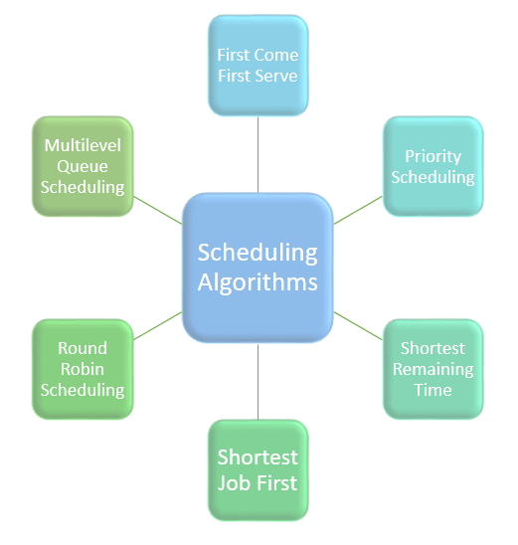
Scheduling Algorithms
In this slideshow I will be focusing on 6 different scheduling algorithms
First-In, First-Out (FIFO)
Shortest Job First (SJF)
Shortest Time to Completion First (STCF)
Round Robin (RR)
Multi-Level Feedback Queue (MLFQ)
Last In, First Out (LIFO)

Slide 4
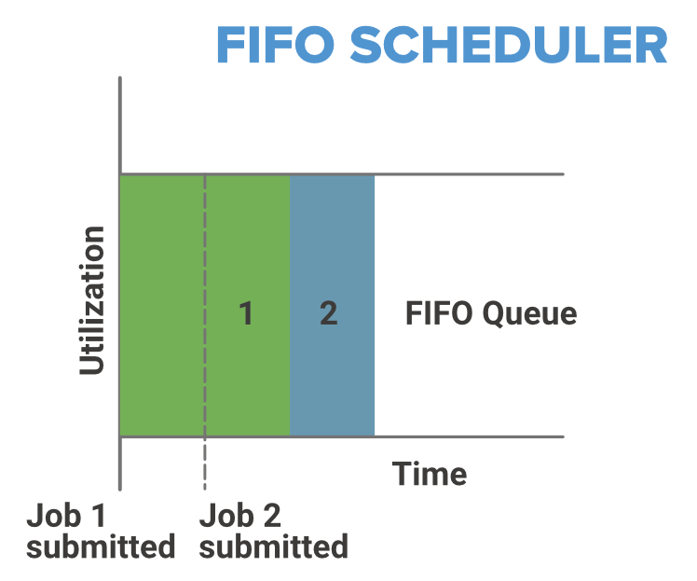
First-In, First-Out (FIFO)
Characteristics of FIFO
Principle is that the first job submitted is the first job that is done regardless of duration
Non-Preemptive (once job is started, it is seen until completion)
If short process are stuck behind long-processes, then there may be a starvation problem so not very efficient

Slide 5
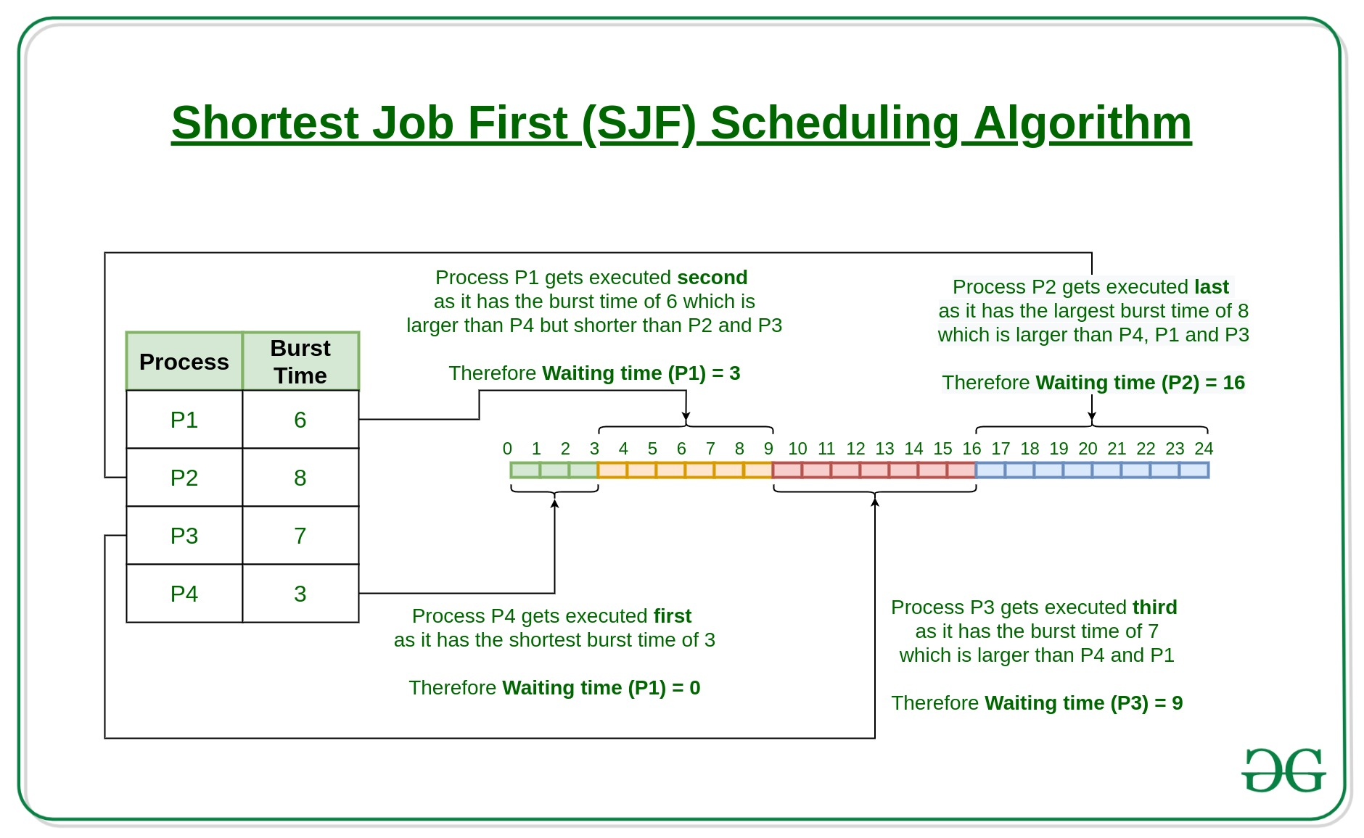
Shortest Job First (SJF)
Characteristics of SJF
Chooses the shortest job to execute first and then the second shortest process is executed next
Best used for long term scheduling
Also suffers from starvation
Sometimes it is hard to predict the duration of the new process

Slide 6
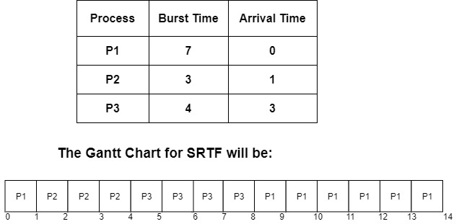
Shortest Time to Completion First (STCF)
Characteristics of STCF
Also known as SRTF which is shortest remaining time first
Job that will finish first in time will be scheduled first
Long processes may take a long time behind short processes
Also suffers from starvation

Slide 7
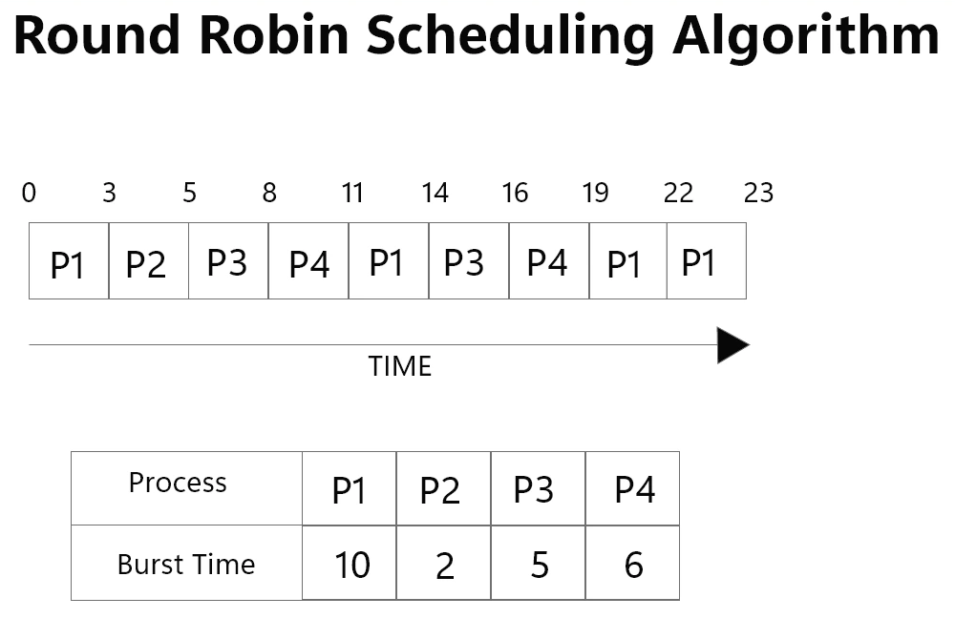
Round Robin (RR)
Characteristics of RR
Each process is assigned a time slot and processed for an equal amount of time
Preemptive algorithm
Does not suffer from starvation
Performance highly depends on number of processes needing to be run

Slide 8
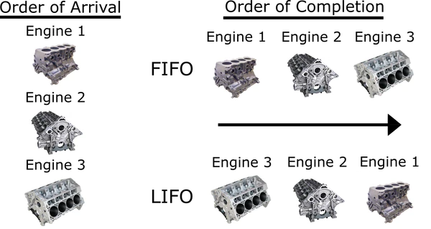
Last-In, First-Out (LIFO)
Characteristics of LIFO
Principle is that the last job submitted is the first job that is done regardless of duration
Non-Preemptive (once job is started, it is seen until completion)
If short process are stuck behind long-processes, then there may be a starvation problem so not very efficient

Slide 9
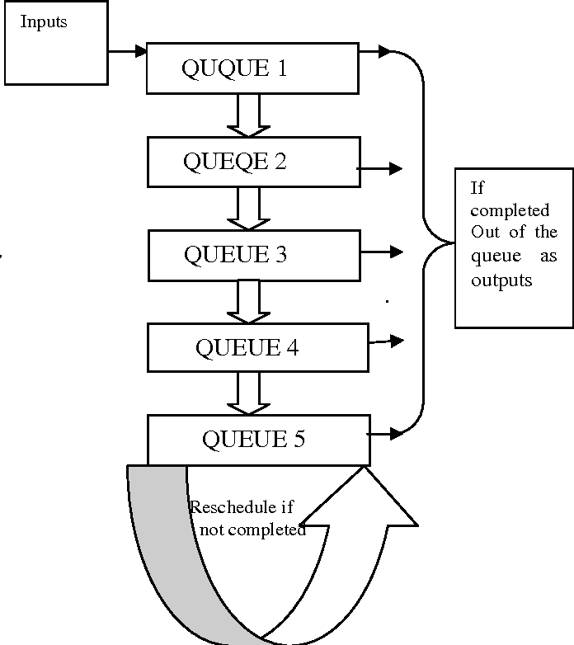
Multi-Level Feedback Queue (MLFQ)
Characteristics of MLFQ
Processes are assigned to a queue when inputted
As processes are completed within a certain amount of time given, they are then moved to another queue
Boosting is done to raise priority levels to avoid starvation

